Slide 1
MUSC Boeing Center for Children’s Wellness
[Insert School Name]
School-based Wellness Initiative

Slide 2
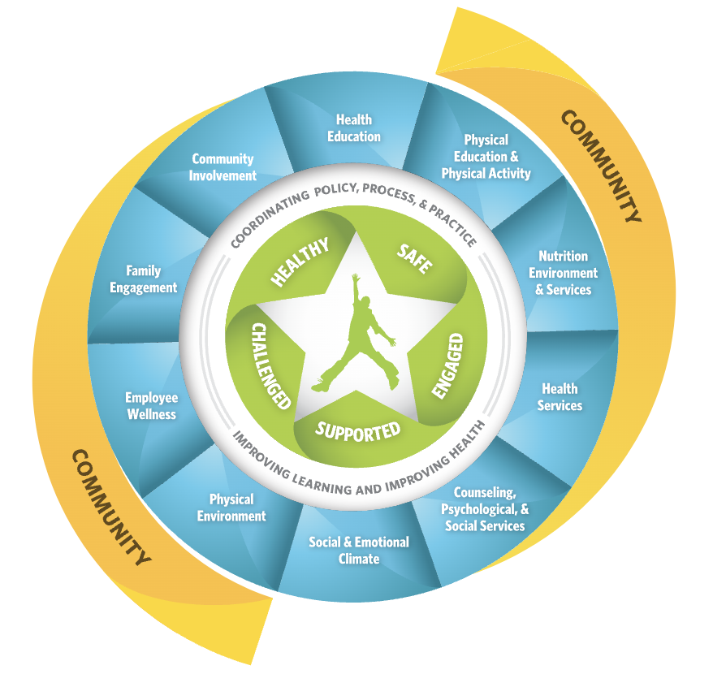
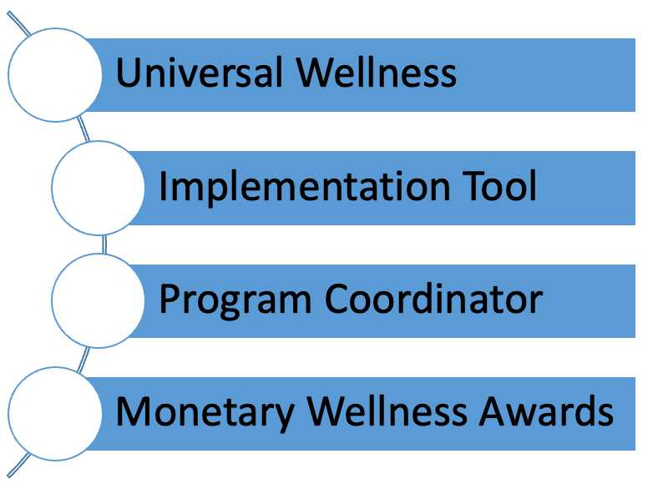
What is the School-based Wellness Initiative
Photo Source: CDC WSCC Model
Notes:
Learn more about the Whole School, Whole Community, Whole Child Model
https://www.cdc.gov/healthyschools/wscc/index.htm
Universal Wellness = every student and every staff member at our school. Open for ALL! (i.e. not just the PE coach and football team or select club)
Implementation Tool = School Wellness Checklist, a menu of evidence-based wellness projects

Slide 3
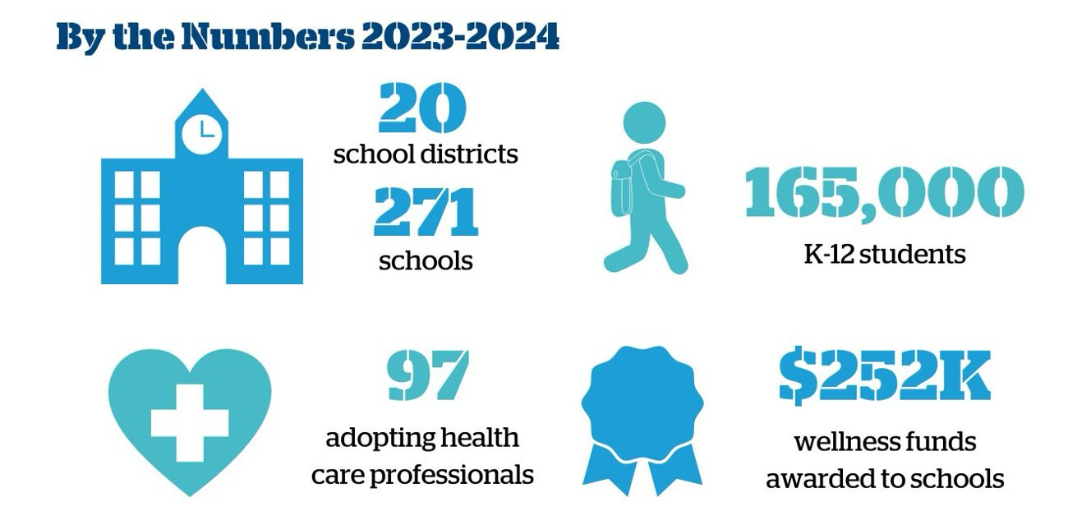
MUSC Boeing Center for Children’s Wellness State-wide Impact
Notes:
Overview of last year's success for every school that participates in MUSC BCCW Initiative statewide

Slide 4
[Insert District Name]
Email Program Coordinator for your district's specific overview
Notes:
Add for the specific district

Slide 5
How it Works
Our school has a wellness committee that meets at least 4 times a year
The committee selects wellness activities and implements wellness strategies that earns our school points each year
We must earn at least 50 points during the school year, a minimum of 1 point in each of the following categories:
  Getting Started
  Nutrition
  Physical Activity
  Social Emotional Wellness
  Wellness Culture
  Staff Wellness
  Sustainability
If we meet these requirements, we earn a wellness award! Help us earn an award and compete against all the other schools in our district for the grand prize.

Slide 6
Wellness Committee Members
Edit as Needed
Wellness Leader:
Principal:
Food Service Manager:
School Nurse:
School Mental Health Counselor:
PE Teacher:
Classroom Teacher:
School Resource Officer:
After-School Program Staff:
Parent:
Student:
Health Professional:
Other Staff Members:
Community Member:
Business or Organization Representative:
Notes:
This is our schools Wellness Committee Members

Slide 7
Award Structure

Slide 8
[Insert School’s Name]
Wellness Mission Statement
[Insert School’s Wellness Committee Mission Statement here for the 24-25 School Year.]
Notes:
Look at your archive report if you have a wellness mission statement or create one together.
Claim 1 point under Getting Started #8

Slide 9
Wellness Committee Goals
Last year we earned [Insert Point Number] points and a wellness award of $[Award Total]
Our Goals for this school year:
  [Insert Goal]
  [Insert Goal]
  [Insert Goal]
Notes:
Get points earned and total award from Archive Report 23-24 School Year.
SMART Goals, claim 3 points under Getting Started #10 by filling out this worksheet

Slide 10
How Can You Help
  Join the wellness committee, our next meeting is [insert meeting date]
  Participate in the wellness activities selected by the wellness committee
  Add wellness activities in your classroom. Then tell [Wellness Lead], our schools Wellness Lead, so we can earn the points for your efforts
  All points must be documented by the Wellness Lead by noon on Friday, May 2nd to count toward our total for the year
Notes:
- Have the School Wellness Checklist available to hand out

